Slide 1
AI Tool for Predicting Market Prices of Crops
EESARI HAMSITHA - 2403A52361
MASKU PRERITA - 2403A52357
N.VISHNU VARDHAN - 2403AA52360

Slide 2
INTRODUCTION
• Growing volatility in crop market prices.
• Need for accurate forecasting tools.
• AI helps farmers make better decisions.

Slide 3
PROBLEM STATEMENT
• Farmers face losses due to unpredictable prices.
• Lack of timely information.
• Market fluctuations affect planning.

Slide 4
How the ai tool works?
• Uses machine learning to analyze past data.
• Considers weather, demand, and market trends.
• Predicts future crop prices.

Slide 5
Models and data used
• Historical price data.
• Weather and seasonal patterns.
• ML models like Linear Regression / Random Forest.

Slide 6
benefits
• Helps farmers decide best time to sell.
• Reduces financial risk.
• Increases profit using data-driven decisions.

Slide 7
Output and predictions
• Displays predicted price charts.
• Weekly and monthly forecasts.
• Easy-to-use dashboard.

Slide 8
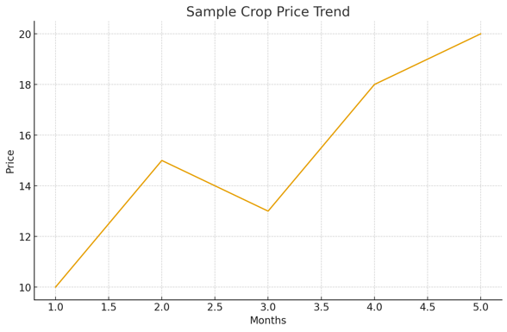
Sample chart:

Slide 9
conclusion
• AI-based price prediction boosts confidence.
• Supports smarter agricultural planning.

